Slide 1
END-TO-END DATA ANALYTICS PROJECT
Python • MySQL • Power BI
Customer Shopping Behavior Analysis
Uncovering customer profiles, purchasing patterns, and revenue drivers across 3,900 retail transactions to optimize subscription & loyalty programs.
Shubham Khatri
GitHub Repository
LinkedIn Profile

Slide 2
EXECUTIVE SUMMARY
Project Scope & Core Business KPIs
Dataset Size: 3,900 Customers
TOTAL REVENUE
AVG PURCHASE VALUE
AVG REVIEW RATING
SUBSCRIPTION RATE
$233K
$59.76
3.75/5.0
27%
3,900 Total Sales
Consistent spend across tiers
Moderate satisfaction
73% Unsubscribed gap
Primary Objective
Core Dataset Scope
Understand demographic behavior, product preferences, and payment habits to drive targeted marketing, subscription growth, and loyalty retention strategies.
18 raw attributes including demographics (Age, Gender, Location), item details, purchase history, shipping options, discounts, and ratings.

Slide 3
PROJECT ARCHITECTURE
End-To-End Data Engineering & Analytics Pipeline
STAGE 01
STAGE 02
STAGE 03
STAGE 04
Raw Data Ingestion
Python Engineering
MySQL Database
Power BI Deck
3,900 transactional records imported from CSV source file into Python environment.
Imputed ratings, standardized schema to snake_case, engineered age quartiles & customer segments.
Cleaned dataset loaded via SQLAlchemy engine. Executed 10 analytical business queries.
Single-page executive dashboard built with dynamic KPI cards, drill-downs, and category breakdown.
Pandas & NumPy
Data Wrangling
Relational Analysis
Visual Storytelling

Slide 4
DATA PREPARATION • PYTHON
Data Quality Auditing & Cleaning Operations
Domain-Aware Median Imputation
37 missing review ratings imputed using category medians rather than global averages to preserve category-specific satisfaction baselines.
customer_analytics.ipynb
Python 3.10
# 1. Impute missing ratings with Category Median
cust_df["Review Rating"] = cust_df.groupby("Category")["Review Rating"] \
.transform(lambda x: x.fillna(x.median()))
Database-Ready Schema Standardization
Converted 18 raw columns to uniform lowercase snake_case formatting for seamless compatibility across MySQL and Power BI layers.
# 2. Standardize column names to snake_case
cust_df.columns = cust_df.columns.str.lower().str.replace(" ", "_")
cust_df.rename(columns={'purchase_amount_(usd)': "purchase_amount"})
# 3. Deduplicate redundant promo code column
cust_df.drop("promo_code_used", axis=1, inplace=True)
Redundancy Elimination
Identified 100% correlation between discount_applied and promo_code_used, dropping duplicate column to prevent data bloat.

Slide 5
FEATURE ENGINEERING • PYTHON
Transforming Raw Data into Business Features
Age Group Quartiles
Frequency Mapping
Customer Segmentation
Divided ages (18-70) into 4 equal-sized demographic quartiles using pd.qcut.
Converted string frequency terms into numeric day intervals for statistical analysis.
Categorized customers by purchase history tiers using pd.cut thresholds.
Quartiles: Young Adult, Adult, Middle-Aged, Senior
Mapping: Weekly $\rightarrow$ 7, Fortnightly $\rightarrow$ 14, Monthly $\rightarrow$ 30, Quarterly $\rightarrow$ 90
Tiers: New (0-1), Returning (2-5), Loyal (6+)
Exported clean 3,900 x 20 dataset to MySQL table 'shop' via SQLAlchemy engine
Zero Null Values

Slide 6
BUSINESS ANALYTICS • MYSQL
Solving 10 Key Business Questions in SQL
Q1. Gender Revenue
Q6. Highest Discounted Items
Male revenue $157.89K (68%) vs Female $75.19K (32%).
Hats (50.0%) and Sneakers (49.66%) rely heavily on discounts.
Q2. High-Value Discount Buyers
Q7. Segment Distribution
Filtered buyers using discounts with spend $\ge$ $59.76 average.
Loyal (3,116), Returning (701), and New (83) customers.
Q3. Top Rated Products
Q8. Top 3 Items per Category
Gloves (3.86) & Sandals (3.84) lead product ratings.
Ranked items within categories using SQL Window Functions.
Q4. Shipping Type Spend
Q9. Repeat Buyer Subscription Gap
Express shipping ($60.48) slightly outperforms Standard ($58.46).
2,518 repeat buyers (>5 orders) remain unsubscribed.
Q5. Subscriber Spend Impact
Q10. Revenue by Age Group
Subscribers spend $59.49 vs Non-subscribers $59.87 (similar order value).
Young Adults lead revenue ($62.14K), followed by Middle-Aged ($59.20K).

Slide 7
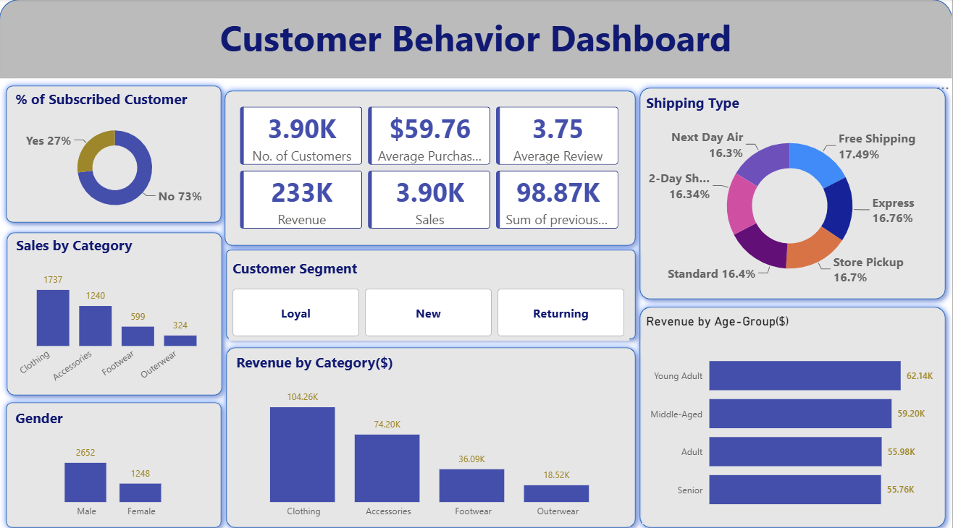
BUSINESS INTELLIGENCE • POWER BI
One-Page Interactive Dashboard Architecture
Executive KPI Header
Instant high-level visibility across revenue, customer volume, average spend, and historical purchase totals (98.87K items).
Customer Behavior Dashboard (Header Bar)
Subscription & Demographic Slicers
Interactive filtering by subscription status (27% vs 73%), gender split, and 4 age quartiles for deep demographic analysis.
Category Performance View
Visual ranking highlighting Clothing as the primary revenue engine ($104.26K) versus Outerwear ($18.52K).

Slide 8
CUSTOMER ANALYTICS
Customer Segmentation & Subscription Gap
Loyal Tier
6+ Purchases
Returning Tier
2-5 Purchases
New Tier
0-1 Purchases
3,116
701
83
Represents 79.9% of total customer base. Strong retention backbone with high repeat transaction potential.
Represents 18.0% of customers. Critical target segment for re-engagement and loyalty program onboarding.
Represents 2.1% of base. Requires immediate follow-up incentives to convert into repeat buyers.
The Subscription Conversion Gap
Out of 3,476 repeat buyers (>5 orders), 2,518 (72.4%) do NOT have an active subscription. Average spend is virtually identical ($59.49 vs $59.87), proving subscribers aren't currently incentivized with exclusive discounts.

Slide 9
REVENUE DRIVERS
Category & Demographic Revenue Contribution
Revenue Distribution by Category
Gender Imbalance
Clothing (1,737 sales)
$104.26K (44.7%)
Male customers generate $157.89K (68%) vs Female $75.19K (32%). Represents an untapped growth market for female apparel targeting.
Accessories
$74.20K (31.8%)
Footwear
$36.01K (15.5%)
Balanced Shipping Preference
Outerwear
$18.52K (8.0%)
All 6 shipping options capture equal market share (16%–17.5%), led slightly by Free Shipping at 17.49%.

Slide 10
STRATEGIC ROADMAP
Data-Driven Business Recommendations
1
2
3
4
Convert Repeat Unsubscribed Buyers
Expand Female Segment Campaigns
Product Bundling Strategies
Incentivize 2nd Purchase for New Tier
Target the 2,518 repeat buyers with exclusive subscriber-only perks (free shipping or 5% recurring discounts) to boost retention.
Launch targeted marketing for female categories (Accessories & Blouses) to balance the current 68% male revenue concentration.
Bundle lower-performing Outerwear ($18.52K) and Footwear ($36.01K) with best-selling Clothing items during seasonal checkouts.
Send automated post-purchase coupon codes within 14 days to transition 83 New buyers into Returning customer status.

Slide 11
PROJECT PORTFOLIO SUMMARY
Shubham Khatri
Skills Matrix & Technical Capabilities
Python Engineering
MySQL Analytics
Power BI
Business Acumen
Pandas, NumPy, Median Imputation, qcut/cut Binning, Feature Mapping, SQLAlchemy.
Subqueries, Aggregations, CASE Statements, CTEs, Window Functions (ROW_NUMBER).
KPI Card Design, Interactive Visuals, Data Storytelling, Filter Contexts.
Customer Segmentation, Revenue Modeling, Retention Strategy, Actionable Recommendations.
Thank You for Your Time & Consideration!
GitHub Repository
LinkedIn Profile

